Slide 1
ITE3162 – Python Fundamentals
Dr. Eric Hitimana

Slide 2
Outlines
Introduction
Data Types and Variables
Operators
Conditional Statements
Python Data Structure
Python Controls
Python Functions
OOP In Python
Python Modules and Packages

Slide 3
Introduction
https://python.org
https://code.visualstudio.com/

Slide 4
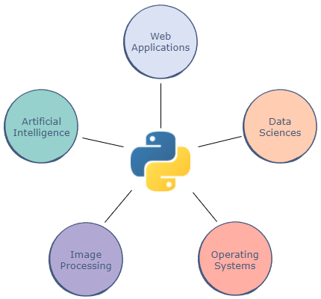
What is python?
Developed in 1990, Python is one of the most popular general-purpose programming languages in modern times.
Characteristics of python:
  A High-level language
  Readability
  Applications

Slide 5
Python Versions
Python has had several major updates in the past.
Python 2.7 was widely used for a very long time, even after the release of newer versions
Python 2.7 has been deprecated as of January 01 2020, and replaced completely by 3.xx
To keep up with the latest technologies, we’ll use Python 3 for this course.

Slide 6

Writing our first code - The print Statement
Every language has a different syntax for displaying or printing something on the screen. The Python file extension is .py
We can print data on the terminal by simply using the print statement.
print (data)
E.g:
Next, we’ll print a few numbers. Each call to print moves the output to a new line:

Slide 7
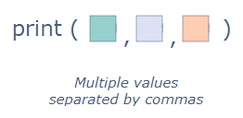

Printing Multiple Pieces of Data
Printing multiple things in a single print command; we must just separate them using commas
If we want multiple print statements to print in the same line, we use the "end" parameter

Slide 8
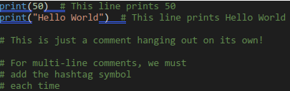

Comments
Comments are pieces of text used to describe what is happening in the code.
A comment can be written using the # character:
An alternative to these multi-line comments (line 4 - 8) are docstrings.
They are encased in triple quotes, """

Slide 9
Example & Exercises
Self-check
What is the command to show the installed version of python?
How do you open vscode in your current directory
What do you think the following code will print “ print(Let's begin) “
How do we run python programs in visual studio code?
Exercise, Task:
Use vscode to create a python file with your name
Write a two lines of code that outputs your name and the phrase “python is fun” on one line.
Execute the program and see the output

Slide 10
Data Types and Variables
The data type of an item defines the type and range of values an item can have.
A variable is simply a name to which a value can be assigned.

Slide 11
Python’s Data Types
Unlike many other languages, Python does not strongly emphasize defining the data type of an object, which makes coding much simpler.
The language provides three main data types:
Number
Strings
Booleans

Slide 12
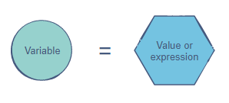
Variables
Variables allow us to give meaningful names to data
The simplest way to assign a value to a variable is through the = operator
Variables allow us to store data so that we can use it later to perform operations in the code
Variables are mutable

Slide 13
Naming Convention
There are certain rules we have to follow when picking the name for a variable:
  The name can start with an upper- or lower-case alphabet.
  A number can appear in the name, but not at the beginning.
  The _ character can appear anywhere in the name.
  Spaces are not allowed. Instead, we must use like snake_case to make variable names readable.
  The name of the variable should be something meaningful that describes the value it holds, instead of being random characters.

Slide 14
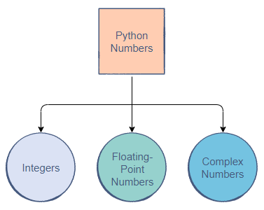
1. Numbers
Python is one of the most powerful languages when it comes to manipulating numerical data
There are three main types of numbers in Python:

Slide 15
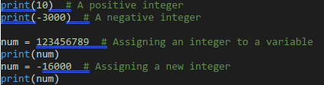
Integer Numbers
The integer data type is comprised of all the positive and negative whole numbers
Note: In Python, all negative numbers start with the - symbol.

Slide 16

Floating Point Numbers
Floating-point numbers, or floats, refer to positive and negative decimal numbers
Python allows us to create decimals up to a very high decimal place
This ensures accurate computations for precise values.
In Python, 5 is considered to be an integer while 5.0 is a float

Slide 17
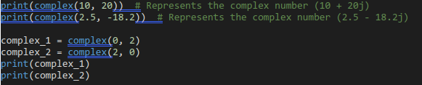
COMPLEX NUMBERS
Python also supports complex numbers
Complex numbers are made up of a real and an imaginary part.
Just like the print() statement is used to print values, complex() is used to create complex numbers
complex(real, imaginary)

Slide 18
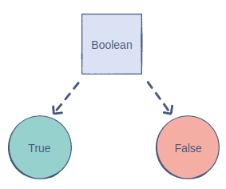
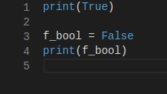
2. Booleans
The Boolean (also known as bool) data type allows us to choose between two values: true and false
A Boolean is used to determine whether the logic of an expression or a comparison is correct.
It plays a huge role in data comparisons

Slide 19
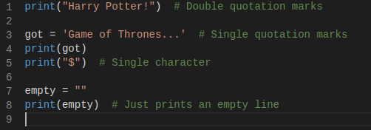
3. Strings
A string is a collection of characters closed within single or double quotation marks.
A group of characters such as "Hello World" is an example of the string data type.
A string can also contain a single character or be empty

Slide 20

The Length of a String
The length of a string can be found using the len statement
This length indicates the number of characters in the string:

Slide 21
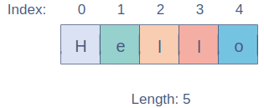
String Indexing
In a string, every character is given a numerical index based on its position.
A string in Python is indexed from 0 to n-1 where n is its length

Slide 22

Manipulating strings
Accessing Characters:
  Each character in a string can be accessed using its index.
  The index must be closed within square brackets, [], and appended to the string
Reverse Indexing:
  We can also change our indexing convention by using negative indices
  Negative indices start from the opposite end of the string
String Slicing: Slicing is the process of obtaining a portion (substring) of a string by using its indices

Slide 23

Manipulating strings …..
Slicing with a Step:
  we can define a step through which we can skip characters in the string
  The default step is 1
Reverse Slicing: Strings can also be sliced to return a reversed substring.
  In this case, we would need to switch the order of the start and end indices.
Partial Slicing: One thing to note is that specifying the start and end indices is optional.
If start is not provided, the substring will have all the characters until the end index.
  If end is not provided, the substring will begin from the start index and go all the way to the end

Slide 24
Example & Exercises
Given the following variable
my_string = "This is My String !"
print(my_string[0])
Print(my_string[len(my_string)])
How would I print the last ! Mark in my_string variable
print(my_string[len(my_string) - 1])
print(my_string[-1])
print(my_string[1:7])
print(my_string[0:7:2])
print(my_string[13:2:-1])
Print(my_string[17:0:-2])
print(my_string[:])
print(my_string[:: -1])

Slide 25
Getting USER input
The Input is nothing but some value from a system or user.
In Python, we have the following two functions to handle input from a user and system
  input(prompt) to accept input from a user
  print() to display output on the console.
  Example:
  name = input("Enter Employee Name ")
  salary = input("Enter salary ")
  company = input("Enter Company name ")
  print("\n")
  print("Printing Employee Details")
  print("Name", "Salary", "Company")
  print(name, salary, company)

Slide 26
Data Type Conversion
When programming, there are times we need to convert values between types in order to manipulate values in a different way
  Converting Integers to Floats : we use float() method
  Converting Floats to Integers: we use int() method
  Converting Numbers to Strings: we use str() method
  Converting Strings to Numbers: we use the int() and float() methods.

Slide 27
Example & Exercises
Write a simple program that prints the total number of characters of a string entered by the user.

Slide 28
Python operators
Operators are used to perform arithmetic and logical operations on data.
They enable us to manipulate and interpret data to produce useful outputs."

Slide 29
Outlines
Python Operators
Conditional Statements

Slide 30

Operators
Python operators follow the in-fix or prefix notations
The 5 main operator types in Python are:
  arithmetic operators
  comparison operators
  assignment operators
  logical operators
  bitwise operators

Slide 31
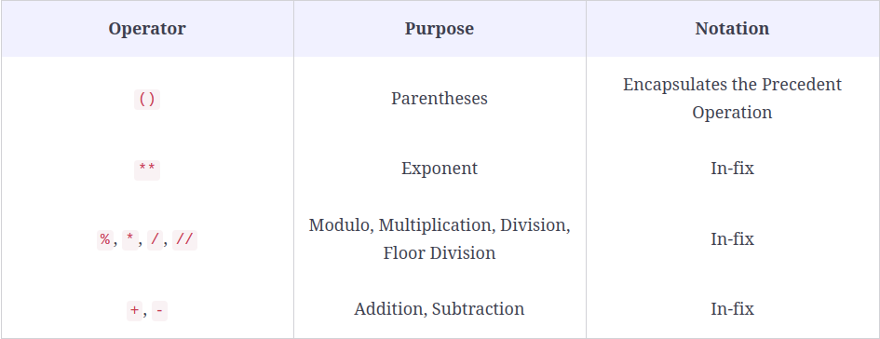
Arithmetic operators
The operator listed higher will be computed first

Slide 32
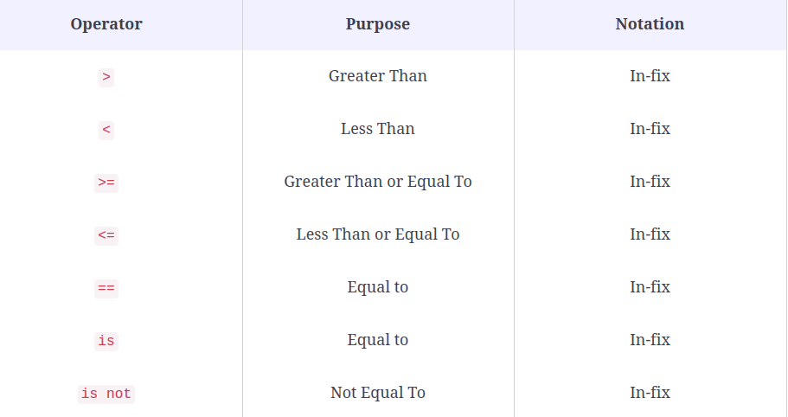
Comparison operators
can be used to compare values in mathematical terms.

Slide 33
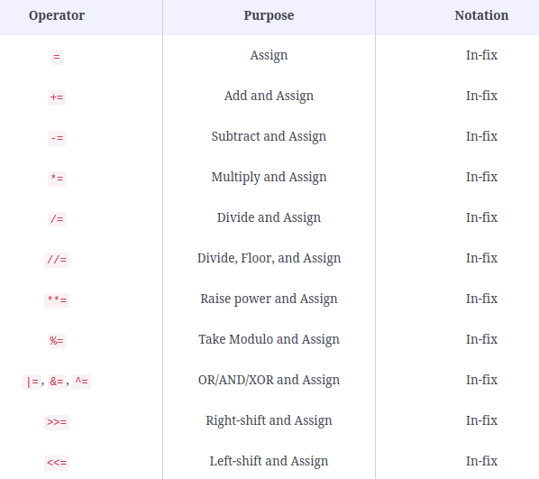
Assignment operators
used to assign values to a variable.

Slide 34
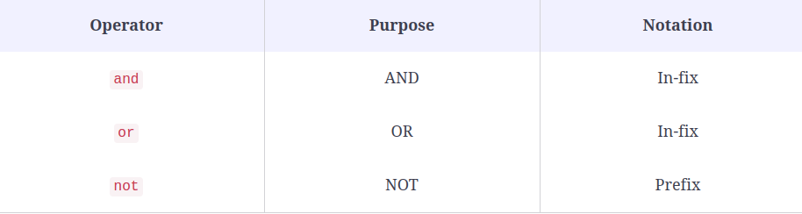
LOGICAL operators
can be used to compare values in mathematical terms.

Slide 35
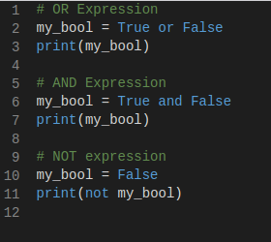
Logical Expressions
Logical operators are used to manipulate the logic of Boolean expressions

Slide 36
String Operations
The string data type has numerous utilities that make string computations much easier
Comparison Operators : Strings are compatible with the comparison operators
When two strings have different lengths, the string which comes first in the dictionary is said to have the smaller value.
Concatenation: The + operator can be used to merge two strings together
The * operator allows us to multiply a string, resulting in a repeating pattern
Search: The in keyword can be used to check if a particular substring exists in another string. If the substring is found, the operation returns true

Slide 37
Example & Exercises
Assuming that variables have the following boolean values:
a = True
b = False
c = a and not b
Enter the result of evaluating the expression:
a and (not c or b)
Exercise
Please, print() the result of the following expression: raise 31 to the power of 331 and then get the remainder of the result's division by 20.
What is the result of the following Python expression? Print(((3 + 5) // 2 * 2 ** 3) % 7).
Find out if the result of dividing A by B is an odd number.
Sample Input 1: 99 & 3 Sample Output 1: True

Slide 38
Exercises
Exercise
The movie theater has cinema halls that can accommodate a certain number of viewers each. Figure out if a movie theater can hold a given number of viewers that plan to visit it on a particular day.
The input format
The first line is number of halls, the second line is their capacity, and the third line is the planned number of viewers.
The output format
True or False.
Sample Input 1:
9
68
589
Sample Output 1:
True

Slide 39
Conditional Statements
"A conditional statement is a Boolean expression that, if True, executes a piece of code".

Slide 40
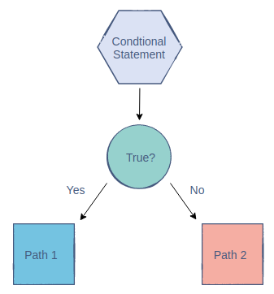
conditional statements
It allows programs to branch out into different paths based on Boolean expressions result in True or False outcomes
conditional statements control the flow of the code and allow the computer to think

Slide 41
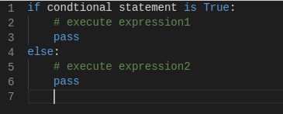
Conditional Statements in Python
There are three types of conditional statements in Python:
if
if-else
if-elif-else

Slide 42
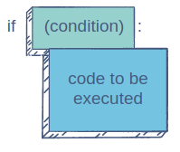
The if Statement
The simplest conditional statement that we can write is the if statement. It comprises of two parts:
The condition
The code to be executed

Slide 43
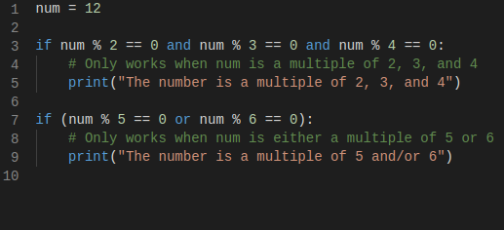
Conditions with Logical Operators
We can use logical operators to create more complex conditions in the if statement.

Slide 44
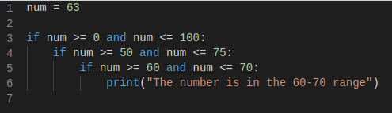
Nested if Statements
A cool feature of conditional statements is that we can nest them.
This means that there could be an if statement inside another!

Slide 45
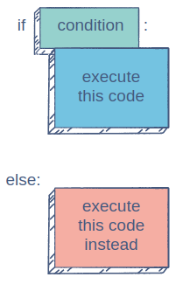
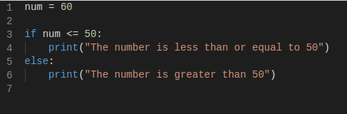
The if-else Statement
What if we wanted to execute a different set of operations in case the if condition turns out to be False?
The else keyword will be on the same indentation level as the if keyword. Its body will be indented one tab to the right just like the if statement.

Slide 46
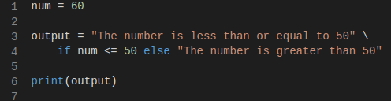
Conditional Expressions
Conditional expressions use the functionality of an if-else statement in a different way
A conditional expression can be written in the following way:
If the if condition is fulfilled, the output would be output_value1. Otherwise, it would be output_value2.

Slide 47
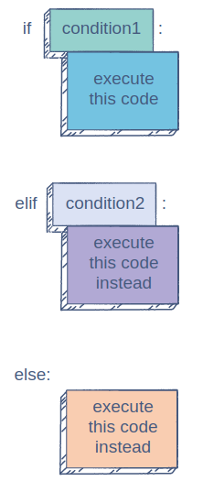
The if-elif-else Statement
It is the most comprehensive conditional statement because it allows us to create multiple conditions easily.

Slide 48
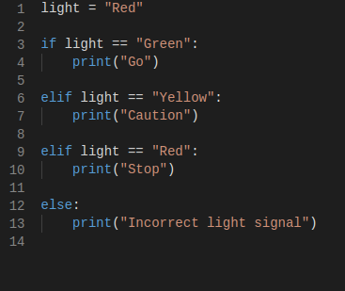
IF-ELIF example

Slide 49
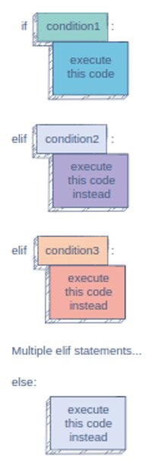
MULTIPLE ELIF STATEMENTS
This is the beauty of the if-elif-else statement.
We can have as many elifs as we require, as long as they come between if and else

Slide 50
Example & Exercises
1. Discounted Price
In this Exercise, you must discount a price according to its value.
If the price is 300 or above, there will be a 30% discount.
If the price is between 200 and 300 (200 inclusive), there will be a 20% discount.
If the price is between 100 and 200 (100 inclusive), there will be a 10% discount.
If the price is less than 100, there will be a 5% discount.
If the price is negative, there will be no discount
Sample Input: price = 250
Sample Output: price = 200

Slide 51
Python DATA STRUCTURES
LIST
DICTIONARY

Slide 52
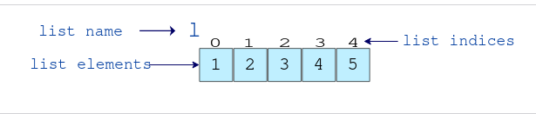
What are lists ?
Python lists are data structures that group sequences of elements.
Lists can have elements of several types, and you can also mix different types within the same list (although all elements are usually of the same datatype).
Lists are created using square brackets [], and the elements are separated by commas (,).
The elements in a list can be accessed by their positions, starting with 0 as the index of the first element.

Slide 53

Sublist
Sometimes you want just a small portion of a list—a sublist.
Sublists are simply subsets of a list; they can be retrieved using a technique called slicing.
Note: The start index is inclusive and end index is exclusive in the range.

Slide 54
Operations on List
List Concatenation
  Lists can be concatenated using the + operator
Traverse a List
  Lists can be iterated over using for loops in Python
List Methods
Python List append()
    Add a single element to the end of the list [ list.append(item) ]
Python List clear()
    Removes all Items from the List [ list.clear() ]

Slide 55
LIST Methods
Python List copy()
  returns a shallow copy of the list
Python List count()
  returns count of the element in the list [ list.count(element) ]
Python List extend()
  adds iterable elements to the end of the list [ list1.extend(iterable) ]
Python List index()
  returns the index of the element in the list [ list.index(element, start, end) ]
Python List insert()
  insert an element to the list [ list.insert(i, elem) ]

Slide 56
LIST Methods
Python List pop()
  Removes element at the given index [ list.pop(index) ]
Python List remove()
  Removes item from the list [ list.remove(element) ]
Python List reverse()
  reverses the list [ list.reverse() ]
Python List sort()
  sorts elements of a list [ list.sort(key=..., reverse=...) ]

Slide 57
Exercises
1. What will be the result of the following syntax:
mylist = ['apple', 'banana', 'banana', 'cherry']
print(mylist[2]).
2. What will be the result of the following syntax:
mylist = ['apple', 'banana', 'cherry']
print(mylist[-1])
3. What will be the result of the following syntax:
mylist = ['apple', 'banana', 'cherry', 'orange', 'kiwi']
print(mylist[1:4])

Slide 58
dictionaries

Slide 59
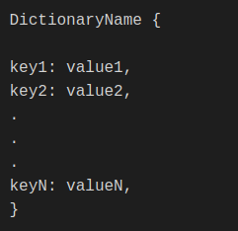
What are dictionaries
Dictionaries are data structures that index values by a given key (key-value pairs).
Dictionaries are written with curly brackets {}, and they have keys and values.
The general syntax for creating a dictionary is:

Slide 60
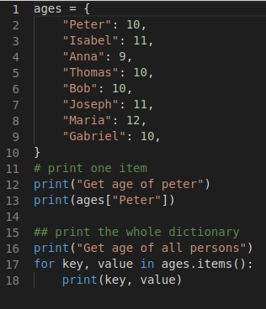
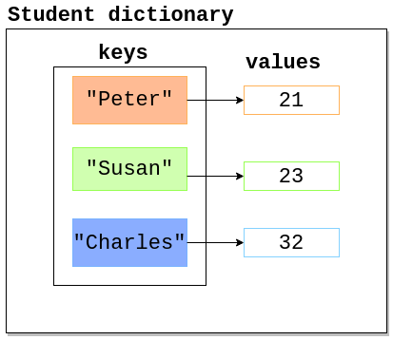
Creating a dictionary
Creating an empty dictionary:
  new_dict = dict()
  new_dict = {}

Slide 61
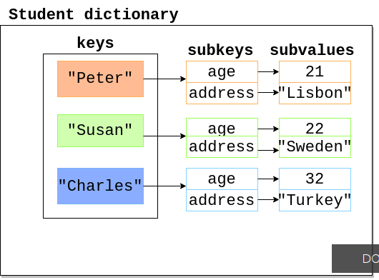
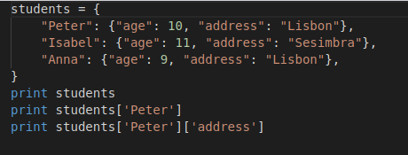
Nested Dictionary
A dictionary can be made within a dictionary, and you can also use other dictionaries as values.

Slide 62
Exercises
1. Create and print a dictionary:
thisdict = {
"brand": "Ford",
"model": "Mustang",
"year": 1964
}
print(thisdict)
2. Print the data type of a dictionary:
thisdict = {
"brand": "Ford",
"model": "Mustang",
"year": 1964
}
print(type(thisdict))
3. Using the dict() method to make a dictionary:
thisdict = dict(name = "John", age = 36, country = "Norway")
print(thisdict)

Slide 63
Python CONTROLS
LOOPS

Slide 64
LOOPS
What are loops
For Loops
Nested For Loops
While Loops
Exercises

Slide 65
What are Loops?
A loop is a control structure that is used to perform a set of instructions for a specific number of times.

Slide 66
Definition
Loops solve the problem of having to write the same set of instructions repeatedly.
Just like conditional statements, a loop is classified as a control structure because it directs the flow of a program by making varying decisions in its iterations
Loops are a crucial part of many popular programming languages such as C++, Java, and JavaScript.

Slide 67
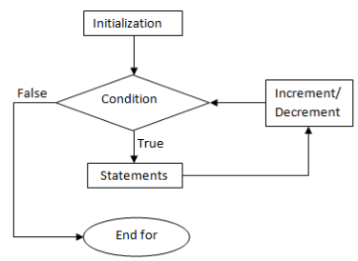
Loops in Python
There are two types of loops that we can use in Python:
The for loop
The while loop

Slide 68
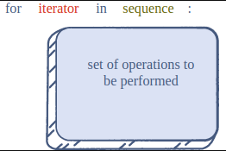
The for Loop
A for loop uses an iterator to traverse a sequence
The iterator starts from the beginning of the sequence.
In each iteration, the iterator updates to the next value in the sequence.
The loop ends when the iterator reaches the end.
Structure:
  The name of the iterator
  The sequence to be traversed
  The set of operations to perform

Slide 69

Looping Through a Range
In Python, the built-in range() function can be used to create a sequence of integers
The end value is not included in the list.
If the start index is not specified, its default value is 0
The optional step decides the number of steps the iterator jumps ahead after each iteration.
if we don’t specify it, the default step is 1

Slide 70
Examples
Sequence of numbers from 1 to 10
A sequence of even numbers between 0 and 20 (inclusive)
A sequence of numbers from 1 to 10 with a step of 3
Print individual letters of a string "PYTHON"
Given the list numbers = [2, 7,10, 16, 23, 54] print a list of square of each number in the list
Given the float_list = [2.5, 16.42, 10.77, 8.3, 34.21] print how many numbers are less than 10.

Slide 71
Nested for Loops
"Python lets us easily create loops within loops"

Slide 72
Execution of Nested Loops
The inner loop will always complete before the outer loop.
Example: Suppose we want to print two elements whose sum is equal to a certain number n
Any Suggestion of the algorithm to use ??

Slide 73
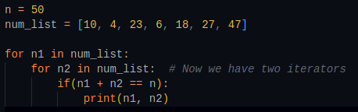
Solution

Slide 74
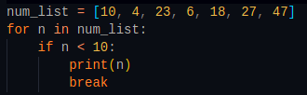
The break Keyword
Sometimes, we need to exit the loop before it reaches the end.
This can happen if we have found what we were looking for and don’t need to make any more computations in the loop.
That’s what the break keyword is for. It can break the loop whenever we want.

Slide 75
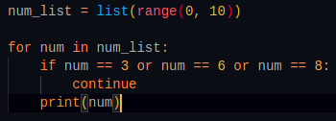
The continue Keyword
When the continue keyword is used, the rest of that particular iteration is skipped.
The loop continues on to the next iteration.

Slide 76
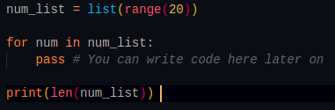
The pass Keyword
In all practical meaning, the pass statement does nothing to the code execution.
It can be used to represent an area of code that needs to be written.
it is used to assist you when you haven’t written a piece of code but still need your entire program to execute

Slide 77
The while Loop
"The while loop keeps iterating over a certain set of operations as long as a certain condition holds True
While this condition is true, keep the loop running"

Slide 78
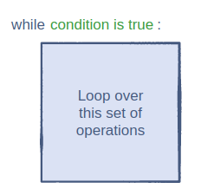
While loop structure
while loop is not always restricted to a fixed range
Its execution is based solely on the condition associated with it.

Slide 79
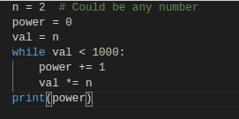
The while Loop in Action
Here’s a while loop that finds out the maximum power of n before the value exceeds 1000

Slide 80
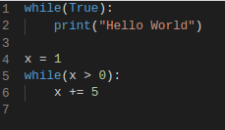
Cautionary Measures
Compared to for loops, we should be more careful when creating while loops.
This is because a while loop has the potential to never end. This could crash a program!

Slide 81
Exercises
1. Create a loop that counts from 0 to 100
2. Make a multiplication table using a loop
3. Output the numbers 1 to 10 backward using a loop
4. Create a loop that counts all even numbers to 10
5. Create a loop that sums the numbers from 100 to 200

Slide 82
Functions in Python
A function is a reusable set of operations

Slide 83
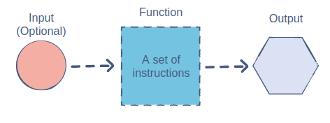
WHY Functions?
Functions are useful because they make the code concise and simple.
The primary benefits of using functions are:
  Reusability: A function can be used over and over again. You do not have to write redundant code.
  Simplicity: Functions are easy to use and make the code readable. We only need to know the inputs and the purpose of the function without focusing on the inner workings.

Slide 84
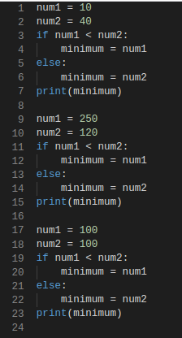
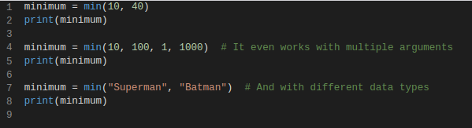
Example
Suppose we want to find the smaller value between two integers.
The good news is that Python already has the min() function:

Slide 85
Types of Functions in Python
There are two basic types of functions in Python:
  Built-in functions: len(), min(), print(),….
  User-defined functions

Slide 86
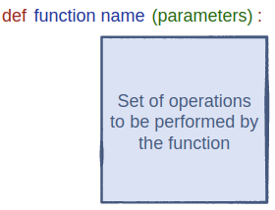
Components of a Function
In Python, a function can be defined using the def keyword
The function name is simply the name we’ll use to identify the function.
The parameters of a function are the inputs for that function. We can use these inputs within the function.

Slide 87
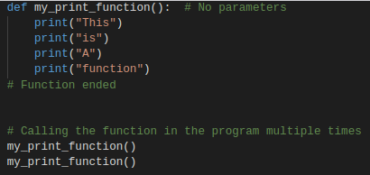
Implementation
Let’s start by making a plain function that prints four lines of text.
We can call the function in our code using its name along with empty parentheses.

Slide 88
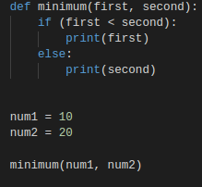
Function Parameters
Parameters are a crucial part of the function structure
They are the means of passing data to the function. This data can be used by the function to perform a meaningful task
The actual values/variables passed into the parameters are known as arguments

Slide 89
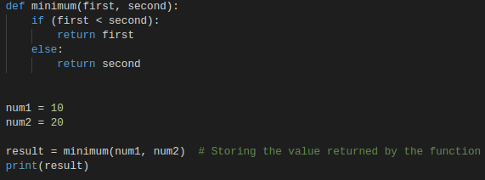
The return Statement
To return something from a function, we must use the return keyword
Keep in mind that once the return statement is executed, the compiler ends the function
Any remaining lines of code after the return statement will not be executed.

Slide 90
Examples & Exercises
1. Write a Python function that accepts a string and calculate the number of upper-case letters and lower-case letters
Sample string: PythOn
Number of Uppercase letters: 2
Number of Lowercase letters: 4
2. Write a function that returns the sum of multiples of 3 and 5 between 0 and limit (parameter). For example, if limit is 20, it should return the sum of 3, 5, 6, 9, 10, 12, 15, 18, 20.
3. Write a Python function to sum all the numbers in a list.
Sample List : (8, 2, 3, 0, 7)
Expected Output: 20

Slide 91
OOp in python
Object-oriented programming, It is a programming paradigm that includes, or relies, on the concept of classes and objects.

Slide 92
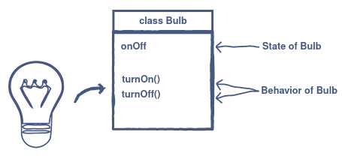
Anatomy of objects and classes
The basic idea of OOP is to divide a sophisticated program into a number of objects that talk to each other.
Objects are a collection of data and their behaviors.
A class can be thought of as a blueprint for creating objects.

Slide 93


Introduction to Objects and Classes
Attributes are also referred to as properties or members. For consistency, we will be using properties throughout the course.
Behaviors are also referred to as member functions or methods. For consistency, we will be using methods throughout the course.

Slide 94

Declaring a Class in Python
Must start with a letter or underscore
Should only be comprised of numbers, letters, or underscores

Slide 95

Implementation of the Employee class
To access properties of an object, the dot notation is used.

Slide 96

Initializing Objects
the initializer (__init__) is used to initialize an object of a class.
It’s a special method that outlines the steps performed when a class object is created in the program.
It’s used to define and assign values to instance variables.
The initializer is a special method because it does not have a return type.
The first parameter of __init__ is self,

Slide 97


use of class variables
The class variables are shared by all instances or objects of the classes.
The instance variables are unique to each instance or object of the class.
Class variables are defined outside the initializer and instance variables are defined inside the initializer.

Slide 98

Implementing Methods in a Class
A method is a group of statements that performs some operations and may or may not return a result.
There are three types of methods in Python:
instance methods (mostly used in Python OOP)
class methods
static methods
These methods can either alter the content of the properties or use their values to perform a particular computation.

Slide 99
Class Methods and Static Methods
Class methods are accessed using the class name and can be accessed without creating a class object.
we use the @classmethod decorator to declare a class method.
Just like instance methods, all class methods have at least one argument.
Static methods can be accessed using the class name or the object name.
we use the @staticmethod decorator to declare a startic method

Slide 100

Access Modifiers in Python
Public attributes are those that can be accessed inside the class and outside the class.
Private attributes cannot be accessed directly from outside the class but can be accessed from inside the class.
By default, methods and attributes are public

Slide 101
Python Modules & Packages

Slide 102

What are python Modules
A Python module is a Python file containing a set of functions and variables to be used in an application.
The variables can be of any type (arrays, dictionaries, objects, etc.)
Types of modules:
  Built-in
  User defined

Slide 103

User-defined Modules
To create a module, create a Python file with a .py extension.
Modules created with a .py extension can be used in another Python source file, using the import statement.

Slide 104

Built-in Modules
There are several built-in modules in Python, which you can import whenever you like.
Benefits of Modules in Python
  Structure Code
    Code is logically organized by being grouped into one Python file which makes development easier and less error-prone.
    Code is easier to understand and use.
  Reusability
    Functionality defined in a single module can be easily reused by other parts of the application.

Slide 105
Python Packages
A package, is like a directory holding sub-packages and modules.
For a directory to become a Python Package it needs to have an __init__.py inside it so that Python can differentiate it from a normal directory.
We Can create our packages or use publicly available packages
Python Package Index(PyPI): is a public repository for Python packages
Python has a package manager called pip which is used to install packages
Packages can be installed system-wide(entire system) or within a specific environment known as a virtual Environment.
Here's the command used to install a package
pip install module-name

Slide 106
Import Modules in Python
To import modules, we use the import statement
import module_name
Import module_name.member_name can be used to import some members(functions) within the module
From module_name import * with this statement we can import all the module members.
From module_name import member_name1, member_name2,.. Using the same approach, you can select the members you want to import by separating each with a comma.

Slide 107
Examples
Import modules in Python
We use the import keyword to do this. To import our previously defined module example, we type the following in the Python prompt.
import example
Using the module name we can access the function using the dot . operator.
example.add(4,5) # returns 9
Create a module, type the following, and save it as example.py.
# Python Module addition
def add(a, b):
result = a + b
return result

Slide 108
Examples
Import Python Standard Library Modules
The Python standard library contains well over 200 modules. We can import a module according to our needs.
Suppose we want to get the value of pi, first we import the math module and use math.pi. For example,
# import standard math module
import math
# use math.pi to get value of pi
print("The value of pi is", math.pi)
Python import with Renaming
In Python, we can also import a module by renaming it. For example,
# import module by renaming it
import math as m
print(m.pi)

Slide 109
Examples
Python from...import statement
We can import specific names from a module without importing the module as a whole. For example,
# import only pi from math module
from math import pi
print(pi)
Import all names
In Python, we can import all names(definitions) from a module using the following construct:
# import all names from the standard module math
from math import *
print("The value of pi is", pi)

Slide 110
Python Virtual Environment
A virtual environment is a tool that helps keep dependencies required by different projects, separated by creating isolated Python virtual environments.
Virtualenv is one of the modules used to create Python environments.
Alternatives are venv, pipenv, conda,....
Installing virtualenv: pip install virtualenv
To create a virtual environment with virtualenv: virtualenv env_name
After running this command, a directory named env_name will be created, and it will have all the necessary tools Python needs to create a Python environment.

Slide 111
Activating virtual environment
A Python virtual env. Needs to be activated.
In the directory where you create the environment, you can run the following command.
On Windows:
env_name\Scripts\activate
On linux/mac:
source env_name/bin/activate
Once active the name of the environment will be displayed on the left side of your terminal/command line interface
Deactiving a virtual env:
deactivate

Slide 112

Thank you

